Slide 1
Firebase – Price Watcher
Adeel Malik

Slide 2
Project Proposal
The project is basically an upgrade of homework 3. Instead of using SQLite, Firebase is used as backend service and user authentication as an additional requirement.
Requirements:
User authentication using Firebase Authentication.
Registered user login
New user signup
Forget password request
Store data on Firebase Realtime Database instead of SQLite.
Add / Update / Delete item records.

Slide 3
Why this project?
To learn something new that we have not covered in class and share the findings with all of you.

Slide 4
Demo
Let’s see the app first and then we will talk about how it’s done…

Slide 5
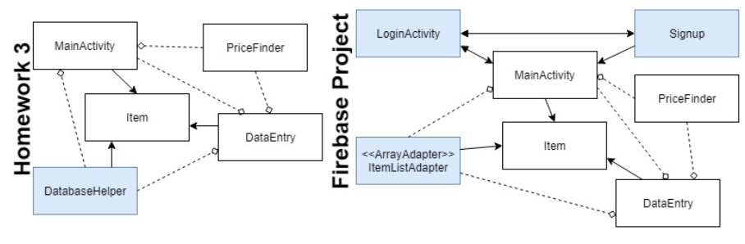
Design Changes
In case of SQLite, a database helper class is used to perform database operations along with SimpleCursorAdapter.
In case of Firebase, we do not need any DatabaseHelper class, but we do need one adapter.
The UML design (without Activities to save space):

Slide 6
What is Firebase
Firebase is a “Backend-as-a-Service” — BaaS — is a comprehensive next-generation app-development platform on Google Cloud.
Main features: Real-time Database, File storage, Authentication and Hosting. Users connect directly to firebase to store and retrieve app data.
Testing: Crashlytics (real-time crash reporting), Performance Monitoring and Test Lab (test apps on devices).
Additional features: Google Analytics(app analytics, events), Cloud Messaging(targeted messaging/notifications), Remote Config (app modifications), Dynamic Links(switching users from web to app ) and App Indexing (autocompleting fields).
More information can be found on the following link: https://firebase.google.com/

Slide 7
Solution Step 1 – Connect your project to Firebase
There are 2 ways to add firebase to your project:
Add your project to firebase console from the web (Manually) https://console.firebase.google.com - login with your Google ID. You have already seen how to do this in the last presentation
Connect to firebase from Android Studio (Automatically)
click tools menu and Firebase option.
Lets see how that can be done…
More information can be found on:
https://firebase.google.com/docs/android/setup

Slide 8
Solution Step 2 – Adding User Authentication
In our case, first requirement is Authentication, lets see how…
Click Tools -> Firebase – A menu on the right side will open for firebase options that you can add.
Click Authentication - > Email and password authentication – if you are already connected, click Add firebase to your app and accept changes.
Section 3 – 6 will provide you the code you need in order to perform the authentication functions.
Requirements User login, sing up and password reset request are covered in this step.

Slide 9
Solution Step 3 – Adding Database Operations
To add database to your project, there are 2 things to do:
Database Structure – How your data will be structured.
Database Rules – This is basically the access levels and security options that you can configure for your database from the firebase console, in order to determine how your data will be accessed, read/write operations.
Lets see …

Slide 10
SQLite Database Structure
Table structure in SQLite database – Table name (items)
← Unique ID for each item Auto generated by SQLite
How the data is stored in the table
ID | AutoIncrement (Primary Key)
ItemName | String
URL | String
Price | REAL
Change | String
ID | ItemName | URL | Price | Change
1 | UTEP Test Item | http://www.cs.utep.edu/cheon/... | 303.17 | Price dropped 30%
2 | Amazon Item | https://www.amazon.com/dp/... | 329.99 | Newly Added Item
3 | Walmart Item | https://www.walmart.com/ip/... | 46.52 | Newly Added item

Slide 11
Firebase Database Structure
Firebase stores the same data in JSON tree structure
{
Items:{
Item_id_1:{
ItemID: 1 ← has to be unique (manually generated)
ItemName: "UTEP Test Item "
URL: "http://www.cs.utep.edu/cheon/..."
Price: 303.17
Change: "Price dropped 30%"
},
Item_id_2:{
ItemID: 2 ← has to be unique (manually generated)
ItemName: " Amazon Item "
URL: " https://www.amazon.com/dp/..."
Price: 329.99
Change: " Newly Added Item "
}
}
}
Firebase provides a function to generate unique ID: FbDbRef.push().getKey()

Slide 12
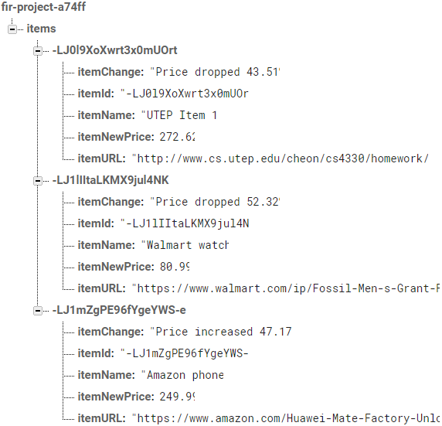
Firebase Database Console view

Slide 13
Database Rules (Firebase)
// These rules allow anyone read or write access to your database
{
"rules": {
".read": true,
".write": true
}
}
Rules can be customized, enabling only authenticated users can read/write specific database items. More information on setting up rules can be found at:
https://firebase.google.com/docs/database/security/
https://angularfirebase.com/lessons/understanding-firebase-database-rules-by-example/

Slide 14
Solution Step 3 – Adding Database Operations
Second requirement is Realtime Database, lets see how…
Click Tools -> Firebase – A menu on the right side will open for firebase options that you can add.
Click Realtime Database - > Save and retrieve data – if you are already connected, click Add the Realtime Database to your app and accept changes.
Section 3 talks about Database Rules. In case of this project, I have kept the minimum security, allowing everyone to read and write.
Section 4 and 5 talks about how you can read and write to the database.

Slide 15
Issues / Problems/ Lessons
1. Gradle terms and dependencies issue:
Terms have been changed e.g. “compile” to “implementation”, “testCompile” to “testImplementation” and getting the right version of dependencies that are compatible with each other and my project was a big issue. In case of my project, I have specified, Android tools to 3.1.3, Google play services to 4.0.1 and firebase to 10.0.1.
2. App to database communication issue:
After database setup, you need to enable “Identity Toolkit API (client-side libraries)” without this, your app will not be able to communicate with the database. To enable this, you need to go to the following link
https://console.developers.google.com/apis/library/identitytoolkit.googleapis.com/
3. App always signed in:
If you do not add the logout code manually on the right places of your app, your app skips login once closed and re-opened.
Sign out code: FirebaseAuth.getInstance().signOut();

Slide 16
Issues / Problems / Lessons continued…
4. Database Options under Firebase:
Firebase provides two options under Database section on web console “Cloud Firestone” and “Realtime Database”. By default Cloud Firestone is selected, change it to Realtime Database. Rules and data storage structure is different for Cloud Firestone.
5. Firebase project limit on portal:
After creating a test project on firebase web portal, if you need to change project settings, go ahead and change the setup inside project configuration. Do not delete the project and create a new one. There is a limit on the free account, even if you delete the project, you can not add new ones after I think 10 projects.
7. Additional consoles related to your Android/Firebase activities:
APIs: https://console.developers.google.com/apis/dashboard?project=fir-project-a74ff
Google Cloud Platform: https://console.cloud.google.com/home?project=fir-project-a74ff
Firebase: https://console.firebase.google.com/project/fir-project-a74ff/

Slide 17
Findings
Add, Update and Delete is as simple as 1, 2, 3 (minimum setup)
Add new item
DatabaseReference FBdbR; //Database Ref.
FBdbR = FirebaseDatabase.getInstance().getReference("items"); //Table Ref.
ItemID = FBdbR.push().getKey(); //Generate unique ID
Item i = new Item(ItemID, item, url, currentPrice, "Newly Added item"); //Obj to add
FBdbR.child(ItemID).setValue(i); //Insert in db
Update an existing item
FBdbR.child(ItemID).setValue(i); //same as adding
//If new id is not provided, existing item is updated/overwritten.
Delete item
//In case of deletion, we need to reference particular child node in the table
FBdbR = FirebaseDatabase.getInstance().getReference("items").child(itemId);
FBdbR.removeValue(); //Remove node from db.

Slide 18
Findings continued…
Platforms supported by Firebase are Android, iOS, Web, C++ and Unity. More info about platforms: https://firebase.google.com/docs/
Data is stored on the cloud that can be accessed from any other devices after login. Do not worry about app data.
Security can be customized from minimum to maximum as per the requirements.
In case of SQLite, data is offline and it can be viewed however, for Firebase, active internet is a must.
Data retrieval time is good but depending on your internet connection, retrieval can be slower.
Matching dependencies can be a problem. Every firebase service requires added dependencies to your project.

Slide 19
SQLite vs Firebase
Name | Firebase Realtime Database | SQLite
Description | Cloud-hosted real-time document store. NoSQL database. iOS, Android, and JavaScript clients share one Realtime Database instance and automatically receive updates with the newest data. | local database on Android device with SQL interface. Widely used in-process RDBMS
Primary database model | Document store | Relational DBMS
Developer | Google | Dwayne Richard Hipp
Initial release | April, 2012 | 2000
License | Commercial, comfortable for rapid development third-party service. | Open Source, independent, absolutely free.
Cloud-based | Yes. A distributed database and it gives real-time streaming support which means a continual input, process and output of data. | No. Not a distributed database where if you want to share data between multiple users you can’t do it with SQLite.
Server operating systems | hosted | server-less
Ref: https://db-engines.com/en/system/Firebase+Realtime+Database%3BSQLite
Notes:
if you want a simple offline only app you can use SQLite but if you want to build a distributed data app go with firebase.

Slide 20
SQLite vs Firebase
Name | Firebase Realtime Database | SQLite
Data scheme | schema-free | yes
SQL | no | yes
APIs and other access methods | Android iOS JavaScript API RESTful HTTP API | ADO.NET JDBC ODBC
Supported programming languages | Java JavaScript Objective-C | Actionscript, Ada, Basic, C, C#, C++, D Delphi, Forth, Fortran, Haskell, Java, JavaScript, Lisp Lua, MatLab, Objective-C, OCaml Perl, PHP, PL/SQL, Python, R, Ruby, Scala, Scheme, Smalltalk, Tcl
Server-side scripts | limited functionality with using 'rules' | no
Foreign keys | no | yes
Concurrency | yes | yes
Durability | yes | yes

Slide 21
Questions
Should we use Firebase or SQLite?
It really depends on your app requirements…
Any other questions?

